Slide 1
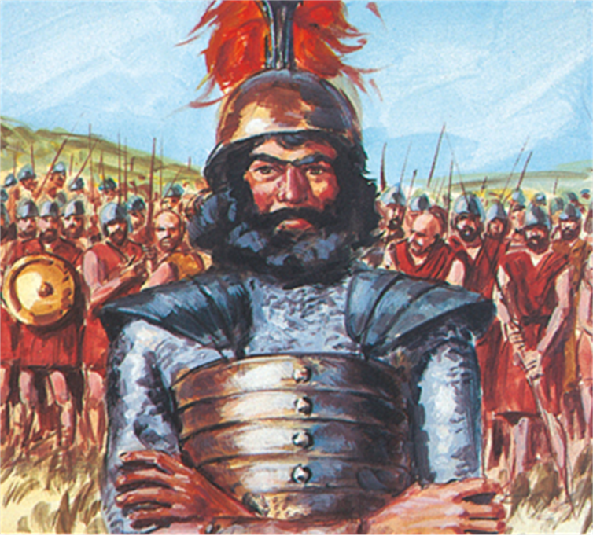
Dumping
David
1 Samuel 29

Slide 2

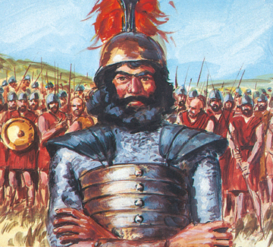
A MASSIVE THREAT
This story continues from 1 Sam 28:1-6
Vs 1: David is in a jam!
KEY: When you hang with evil people,
you will have problems in your life.
Twice David spared Saul’s life, but now
he is with those that are the instrument
of Saul’s death.
Living lost will demand that you come against God’s people!

Slide 3
Psalm 26:1-5 A Psalm of David. 1 Judge me, O LORD; for I have walked in mine integrity: I have trusted also in the LORD; therefore I shall not slide. 2 Examine me, O LORD, and prove me; try my reins and my heart. 3 For thy lovingkindness is before mine eyes: and I have walked in thy truth. 4 I have not sat with vain persons, neither will I go in with dissemblers. 5 I have hated the congregation of evil doers; and will not sit with the wicked.

Slide 4
Proverbs 24:1 Be not thou envious against evil men, neither desire to be with them.
Proverbs 4:14 Enter not into the path of the wicked, and go not in the way of evil men.
Psalm 1:1 Blessed is the man that walketh not in the counsel of the ungodly, nor standeth in the way of sinners, nor sitteth in the seat of the scornful.

Slide 5
Exodus 23:2a Thou shalt not follow a multitude to do evil;
Exodus 34:12 Take heed to thyself, lest thou make a covenant with the inhabitants of the land whither thou goest, lest it be for a snare in the midst of thee:
Ephesians 5:11 And have no fellowship with the unfruitful works of darkness, but rather reprove them.
2 Thessalonians 3:6 Now we command you, brethren, in the name of our Lord Jesus Christ, that ye withdraw yourselves from every brother that walketh disorderly, and not after the tradition which he received of us.

Slide 6
2 Corinthians 6:14-16 Be ye not unequally yoked together with unbelievers: for what fellowship hath righteousness with unrighteousness? and what communion hath light with darkness? 15 And what concord hath Christ with Belial? or what part hath he that believeth with an infidel? 16 And what agreement hath the temple of God with idols? for ye are the temple of the living God; as God hath said, I will dwell in them, and walk in them; and I will be their God, and they shall be my people.

Slide 7
A SPOT-ON ACCUSATION
“these Hebrews” – ethnic identity.
The princes had more sense than
their king!
Achich’s defense of David.
The princes were not stupid!
They didn’t understand that David
could never be reconciled to Saul.
The picture! “adversary” = satan.

Slide 8
2 Corinthians 11:13-14 For such are false apostles, deceitful workers, transforming themselves into the apostles of Christ. 14 And no marvel; for Satan himself is transformed into an angel of light.

Slide 9
SATAN KNOWS WHO YOU ARE.

Slide 10
John 15:19 If ye were of the world, the world would love his own: but because ye are not of the world, but I have chosen you out of the world, therefore the world hateth you.
The world is never
really your friend!

Slide 11
Our place is
WITH GOD’S people!

Slide 12
Ephesians 4:16 From whom the whole body fitly joined together and compacted by that which every joint supplieth, according to the effectual working in the measure of every part, maketh increase of the body unto the edifying of itself in love.
Philippians 3:20 For our conversation is in heaven; from whence also we look for the Saviour, the Lord Jesus Christ:

Slide 13
A DELUDED CONFIDENCE
Achish confirms his confidence in David in THE LORD’S name!
Being dumped by the world is a good thing!

Slide 14
1 Corinthians 10:13 There hath no temptation taken you but such as is common to man: but God is faithful, who will not suffer you to be tempted above that ye are able; but will with the temptation also make a way to escape, that ye may be able to bear it.
Jude 1:24-25 Now unto him that is able to keep you from falling, and to present you faultless before the presence of his glory with exceeding joy, 25 To the only wise God our Saviour, be glory and majesty, dominion and power, both now and ever. Amen.

Slide 15
2 Peter 2:9 The Lord knoweth how to deliver the godly out of temptations, and to reserve the unjust unto the day of judgment to be punished:
What David escapes in this battle… Saul receives in it

Slide 16

A DELUDED CONFIDENCE
Getting dumped still hurts.
David’s protest!
  David objects.
  David promotes.
Three times Achish defends
David! Vs 3,6 and 9!
Three times Pilate declared Jesus
without fault. (John 18:38; 19:4, 6

Slide 17
Satan is in the business of taking God’s people captive!

Slide 18
OUR SIN CAN HURT OTHERS.

Slide 19
Dumping
David
1 Samuel 29

